Slide 1
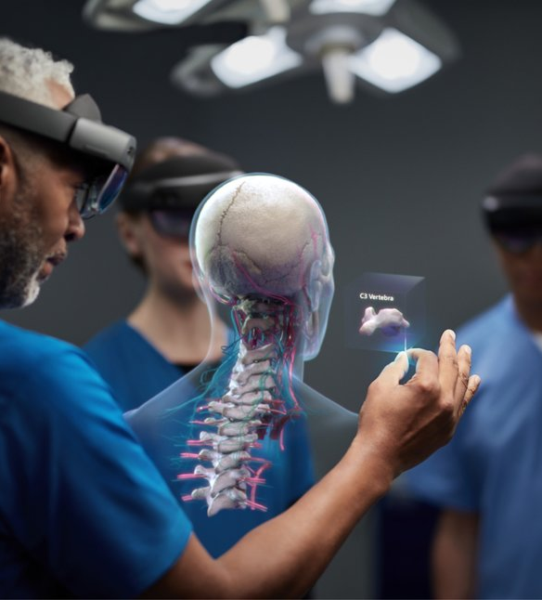
A Holographic Augmented Reality Interface for Visualizing of MRI Data and Planning of Neurosurgical Procedures
Seminar Guide:
Prof. Jikku Thomas
Assistant Professor
Dept of CSE
Presented by:
Aiswarya Raju
S7 CSE A
SJC19CS007

Slide 2
Course Outcome
CO1 : Identify academic documents from the literature which are related to her/his areas of interest (Cognitive knowledge level: Apply)
CO2 : Read and apprehend an academic document from the literature which is related to her/ his areas of interest (Cognitive knowledge level: Analyze)
CO3 : Prepare a presentation about an academic document (Cognitive knowledge level: Create)
CO4 : Give a presentation about an academic document (Cognitive knowledge level: Apply)
CO5 : Prepare a technical report (Cognitive knowledge level: Create)
02

Slide 3
Contents
01
02
03
04
Existing System
Proposed System
Abstract
Introduction
05
06
07
08
Methodology
Testing
Results
Conclusion
03

Slide 4

Abstract
Augmented reality has been proposed as a solution to overcome some of the current shortcomings of image-guided neurosurgery.
Platform generates a HAR scene for planning an access path to the targeted pathology.
Operator can manipulate the images and perform path planning using voice and gestures.
Immersive experiences can be an unparalleled tool for planning neurosurgical procedures.
HAR – Holographic Augmented Reality
04

Slide 5
Introduction
The latest development in medical imaging technology focuses on the acquisition of real-time information and data visualization.
Obtaining real-time access to 2D or 3D reconstructed images during an ongoing surgery can prove to be crucial.
Real-time access is further enhanced by the introduction of augmented reality (AR)—a fusion of projected computer-generated (CG) images and real environment.
05

Slide 6
What is an MRI Scanner?
A test that creates clear images of the structures inside your body using a large magnet, radio waves and a computer
Healthcare providers use MRIs to evaluate, diagnose and monitor several different medical conditions.
The magnetic field temporarily realigns water molecules in your body. Radio waves cause these aligned atoms to produce faint signals, which are used to create cross-sectional MRI images like slices in a loaf of bread.
Types of MRI – Open and Closed
06

Slide 7
Challenges in Existing System
MRI guidance offers a vast volume of 3D information, clinical practitioners need to view and plan in two-dimensional (2D) displays
A significant challenge for clinicians is to mentally extract 3D features and their spatial relationships by viewing multiple 2D MRI slices from 3D or multi-slice sets
Understanding the complex 3D architecture of the tissue, especially considering multi-contrast 3D imaging data sets, is challenging and time-consuming.
Many groundbreaking rendering techniques have been introduced to enable 3D visualization, but 2D visualization remains the standard practice.
07

Slide 8
Proposed System
Platform that establishes a data and command pipeline that integrates the MRI scanner/data, computational modules for image processing and rendering, and the operator via a holographic AR interface for performing MRI-guided interventions.
The platform has certain software architecture and computational features selected based on operational needs and criteria set by collaborating clinicians:
(i)speed of data access
(ii) interactive manipulation of images and objects
(iii) interaction with the system front-end as hands-free as possible.
Proposed platform’s design expanded upon the concept that the HMD acts as a human and data interface.
A separate processor (the Host PC) performs most of the processing to eliminate latencies and enable efficient computation
HMD – Head Mounted Displays
08

Slide 9
Methodology
09

Slide 10
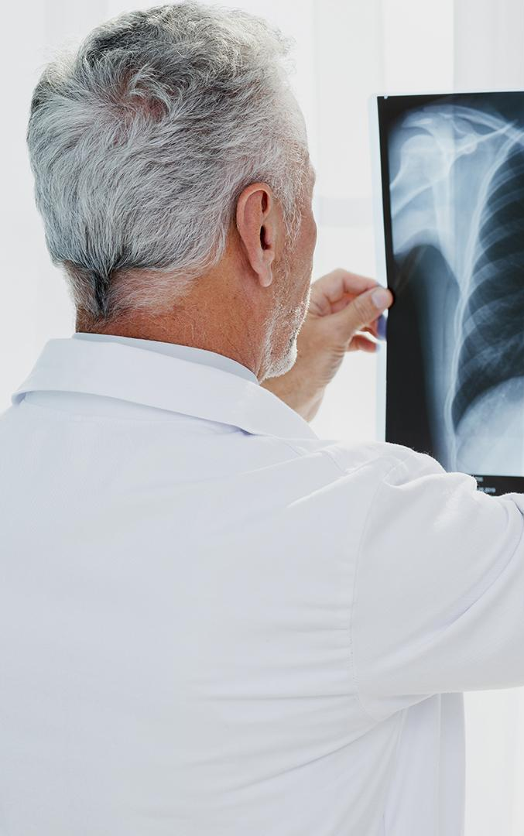
Holographic Augmented Reality(HAR) Platform
What is HAR?
AR is an enhancement of real-world computer-generated information. Using AR glasses, the user sees the environment he/she is in and the glasses display holograms harmonizing with the setting
10

Slide 11
How does the HAR interface work?
HAR interface is implemented using Microsoft HoloLens
What is HoloLens?
It is a device resembling goggles with a built-in battery, microcomputer, cameras, microphone, speakers, and holographic projectors.
Installed depth cameras analyze the entire environment around the user and the microcomputer decides on a way of displaying a hologram
11

Slide 12

System used in HAR
The system’s computational component was deployed in a two-CPU fashion
HoloLens
External PC(Host PC)
The use of the Host-PC, was adopted to address the limited capabilities of the HoloLens Processor
Host PC enables real-time interactive manipulation of the HAR scene based on a computational framework, called the Framework for Interactive Immersion into Imaging Data (FI3D)
12

Slide 13
Modules
The Host-PC is composed of three primary modules
Input
Module
Rendering
Module
Communication Module
13

Slide 14
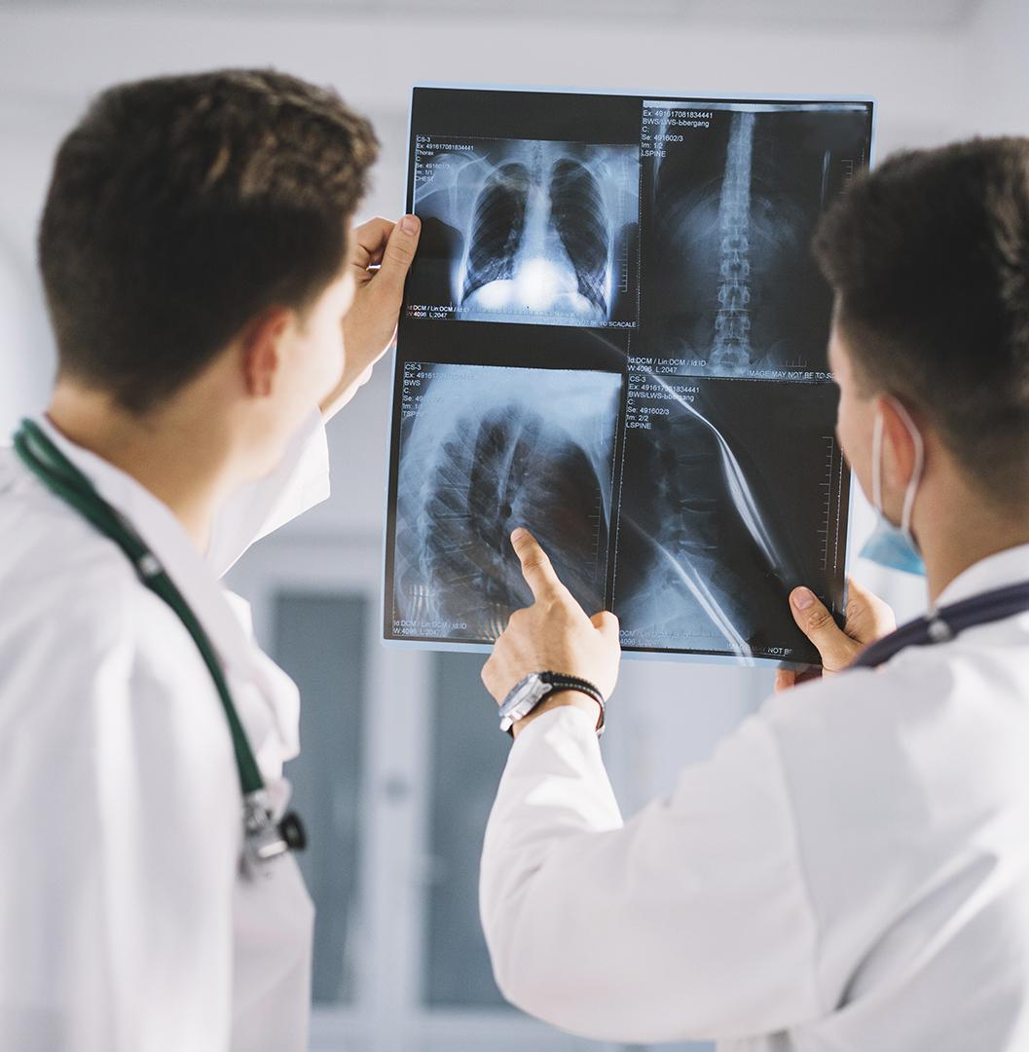
Input Module
The input module receives data from either a storage device and/or directly from the MRI scanner via a dedicated TCP/IP connection
The module extracts spatial information from the corresponding DICOM header
The extracted information is then fed to the rendering module
DICOM – Digital Imaging & Communications in Medicine
14

Slide 15
Rendering Module
Consists of three operation
i) Segmentation
ii) Rendering
iii) Classification
Segmentation is the process of partitioning a digital image into multiple image segments
Rendering generates two-dimensional or three-dimensional image
15

Slide 16
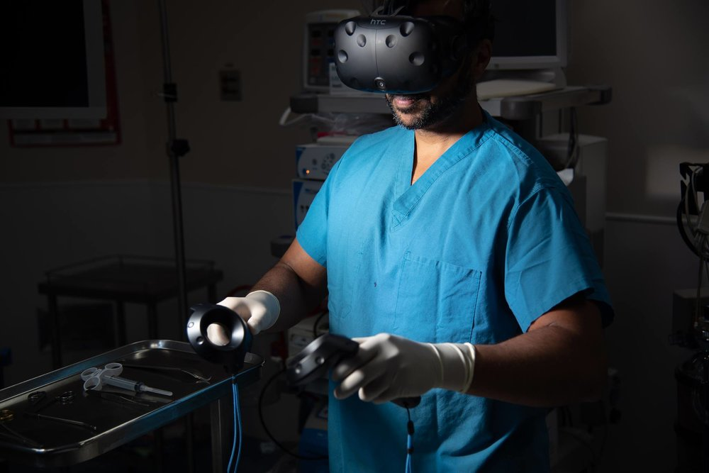
Communication Module
Manages the connection and interaction between Host-PC and HoloLens
HoloLens constantly sends its current status by translating the gestures into a request message formatted in JSON and sent to the Host-PC
The Host PC decodes the JSON string, performs the required tasks, and transmits the process’s result to HoloLens
JSON - JavaScript Object Notation
16

Slide 17
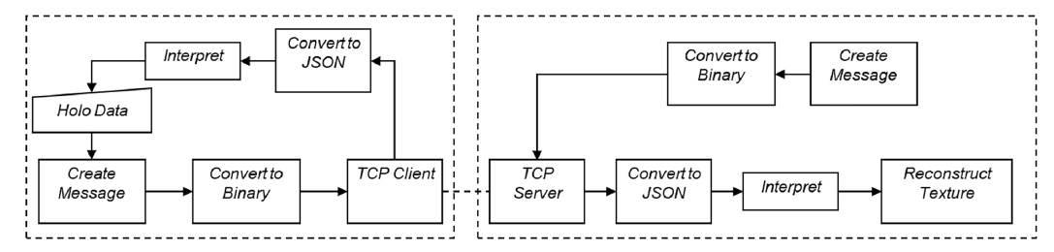
Communication of Host-PC and HoloLens
The communication of the Host-PC (left dashed box) and HoloLens (right dashed box)
17

Slide 18
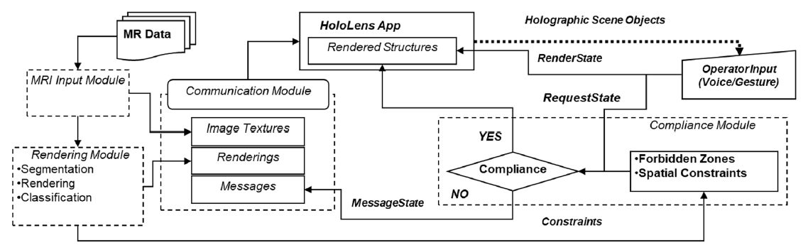
Architecture of HAR
The architecture of the HAR computational core depicting its modules and their interconnectivity
18

Slide 19
Inherent Coordinate System
All calculations, segmentations and objects in the holographic scene are relative to the MRI scanner coordinate system.
Inherent coordinate system is an essential feature for three reasons:
i) MRI represents real space for the interventionists
ii) Selected targeted structures to become relative to the operating room space
iii) Any area selected in the holographic space for additional scanning can immediately be sent
to the MRI scanner for updated data collection
All the presented studies were performed by accessing pre-acquired MRI data sets using the coordinate system
19

Slide 20
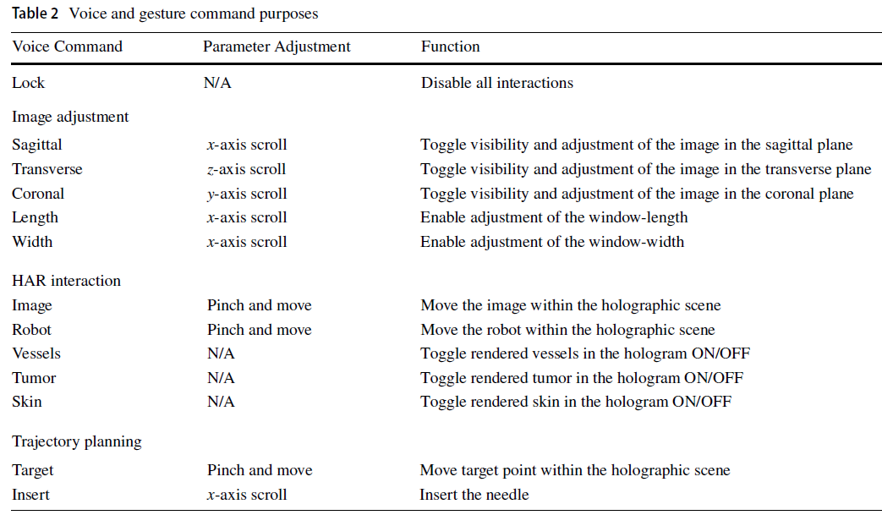
20

Slide 21
Operator-controlled functionalities of the HAR using MRI and
the renderings of segmented structures from a healthy subject.
21

Slide 22
An example holographic output of a meningioma patient showing the blood vessels, meningioma, and patient skin extracted from the MRI data set
22

Slide 23

Planning & Safety Control
Selection of a stereotactic access trajectory entails two steps
i) Selecting the target point
ii) Interactively setting the trajectory to this point
During planning, the software continuously runs two tests.
First as the operator adjusts the orientation of the trajectory
a) a collision module check is conducted
b) if a warning occurs, the software updates all
vital structures in the hologram as well as on 2D virtual display
23

Slide 24
Testing
Three sets of studies were performed :
i) Ergonomics
ii) Assessment of protocols
iii) Characterizing system latencies
Certain conditions were followed such as :
i) lighting conditions were optimized in pilot tests
ii) User need to wear the HoloLens continuously and not remove it
Testing of the system further included the evaluation of possible workflows to
perform neurosurgical needle-based interventions.
24

Slide 25
Results
The holographic AR visualization was subjectively found to be superior over desktop-based volume rendering in regard to
i) 3D appreciation of the spatial relationship of segmented structures
ii) detection and collision avoidance of critical structures
iii) ergonomics and ease in selecting a trajectory
25

Slide 26
Results
26

Slide 27

Conclusion
A preliminary qualitative evaluation revealed the holographic visualization of high-resolution 3D MRI data
It offers an intuitive and interactive perspective of the complex brain vasculature and anatomical structures
A holographic augmented reality interface was implemented for interactive visualization of 3D MRI data and planning trajectories for accessing targeted tissue with straight paths
27

Slide 28
Reference
[1] Morales Mojica, C.M., Velazco-Garcia, J.D., Pappas, E.P. et al. A Holographic Augmented Reality Interface for Visualizing of MRI Data and Planning of Neurosurgical Procedures. J Digit Imaging 34, 1014–1025 (2021). https://doi.org/10.1007/s10278-020-00412-3
[2] Kersten-Oertel M, Gerard IJ, Drouin S, et al: “Towards Augmented Reality Guided Craniotomy Planning in Tumour Resections,” Springer, Cham, pp. 163–174, 2016.
[3] Kim KH, “The Potential Application of Virtual, Augmented, and Mixed Reality in Neurourology,” Int Neurourol J, 20(3):169–170, 2016.
[4] Chen AD and Lin SJ, “Discussion: Mixed Reality with HoloLens: Where Virtual Reality Meets Augmented Reality in the Operating Room.,” Plast Reconstr Surg, 140(5):1071–1072, 2017.
[5] Nabavi A, Gering DT, Kacher DF, et al: “Surgical Navigation in the Open MRI,” in Acta Neurochirurgica, Supplement, 85:121–125, 2003.
[6] P. Vávra, J. Roman, P. Zonča, P. Ihnát, M. Němec, J. Kumar, N. Habib, A. El-Gendi, "Recent Development of Augmented Reality in Surgery: A Review", Journal of Healthcare Engineering, vol. 2017, Article ID 4574172, 9 pages, 2017. https://doi.org/10.1155/2017/4574172
28

Slide 29
Thank You!

